Slide 1
INFOSYS SPRINGBOARD VIRTUAL INTERNSHIP 7.O(Data Analysis)
Advanced Threat Incident Analytics & Security Visualization Framework
Power BI Analytics Project — Final Presentation
From data preparation to predictive, executive-level security intelligence
Prepared by: Hansika Shaw

Slide 2
PROJECT OVERVIEW
From Raw Incident Data to Executive Risk Intelligence
01
02
03
04
Data Foundation
Threat & Geo Intelligence
Temporal & Response Analytics
Risk, Prediction & Executive View
Clean, integrate & model incident, location, weather and response datasets with a fact-dimension structure.
Classify incidents by severity and identify geographical hotspots and risk cities.
Analyze hourly-to-seasonal patterns, activity spikes and response performance.
Assess security risk, forecast future activity, and consolidate insights for leadership.
Toolset: Microsoft Power BI • Fact–Dimension Data Modeling • Power BI Time-Series Forecasting
The framework was built incrementally across four milestones — starting from cleaned, modeled data and growing into a full risk-assessment and predictive-intelligence suite used for strategic decision-making.
Advanced Threat Incident Analytics & Security Visualization Framework INFOSYS Springboard
02

Slide 3
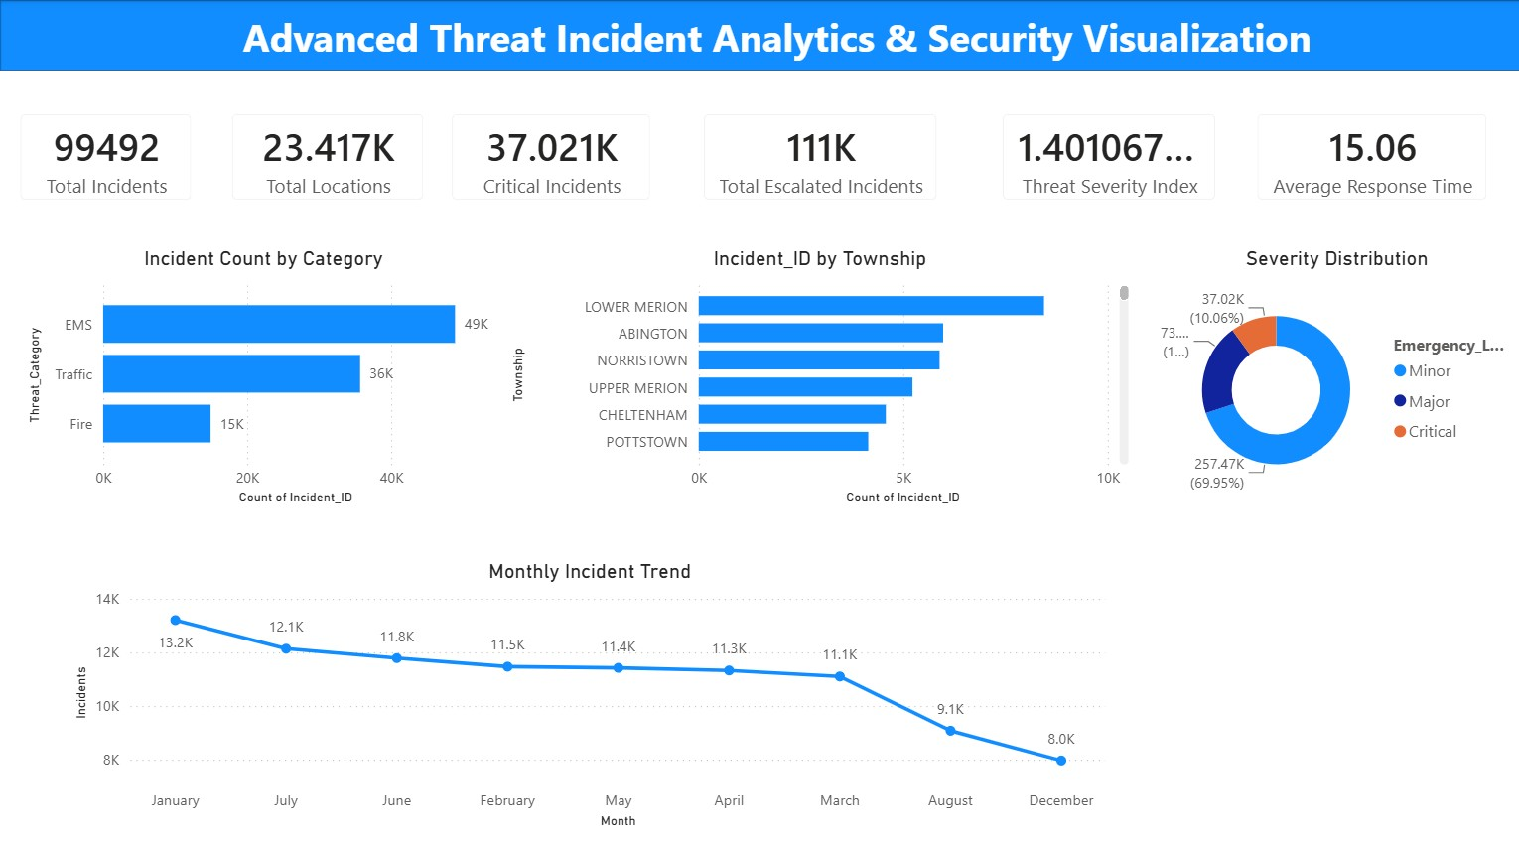
MILESTONE 1
Data Preparation & Foundation Dashboard
Multiple incident, location, weather and response datasets were cleaned and standardized, then modeled using a fact-and-dimension structure (Fact_Incident linked to Dim_Date, Dim_Location, Dim_Weather, Dim_Response).
99,492
23.4K
Total Incidents
Total Locations
37.0K
15.06
Critical Incidents
Avg. Response Time
Key takeaway: standardized, well-modeled data is the foundation for all downstream security analysis.
Advanced Threat Incident Analytics & Security Visualization Framework INFOSYS Springboard
03

Slide 4
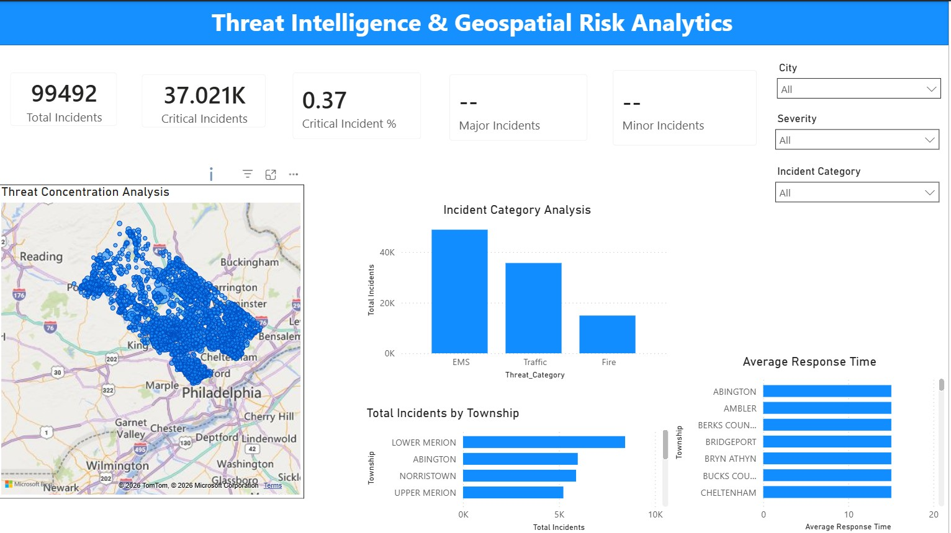
MILESTONE 2
Threat Intelligence & Geospatial Risk Analytics
Dashboard Highlights:
Classifies incidents into Minor, Major and Critical severity levels
Identifies geographical hotspots via a Top-10 risk-city analysis
Compares response-time performance across cities
Interactive slicers for date, category, severity and city
Insight
Lower Merion, Abington and Norristown emerge as the highest-concentration risk locations.
Advanced Threat Incident Analytics & Security Visualization Framework INFOSYS Springboard
04

Slide 5
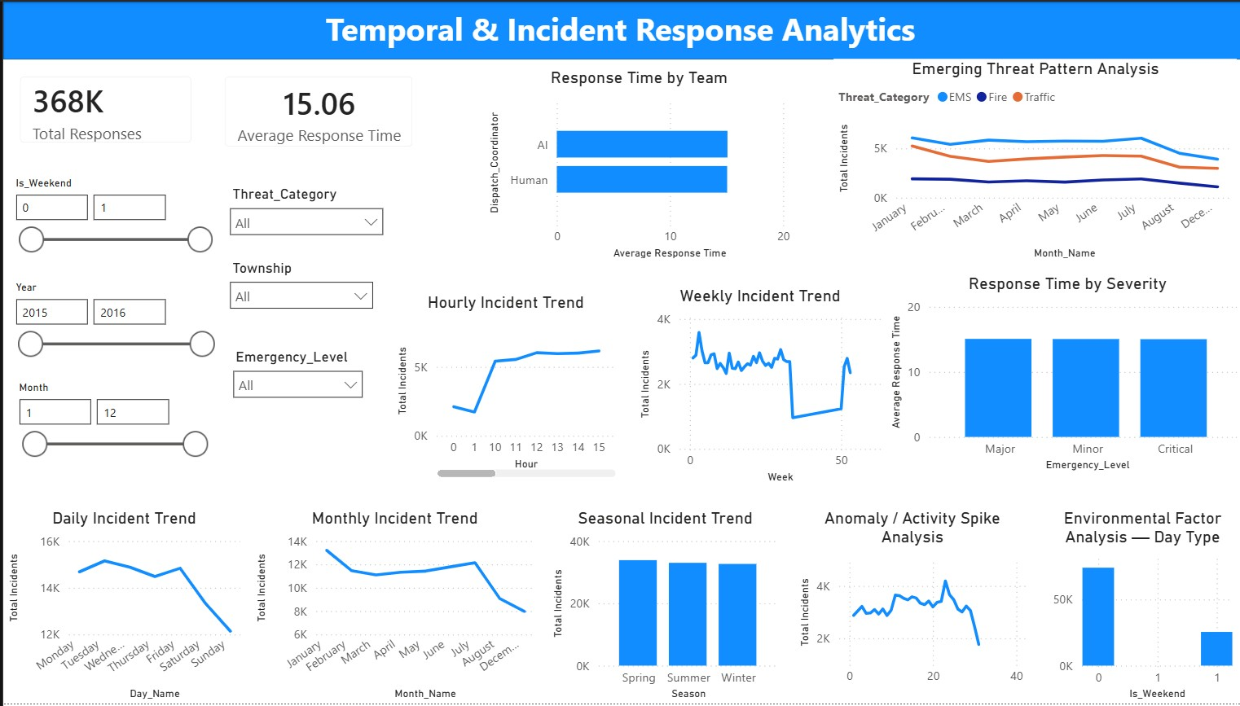
MILESTONE 3
Temporal Incident Analytics & Response Performance
Two Analytical Areas:
Hourly, daily, weekly, monthly & seasonal incident trends
Activity-spike & emerging threat-pattern analysis
Response time by dispatch coordinator, city & severity
368K total responses tracked; avg. response time 15.06
Advanced Threat Incident Analytics & Security Visualization Framework INFOSYS Springboard
05

Slide 6
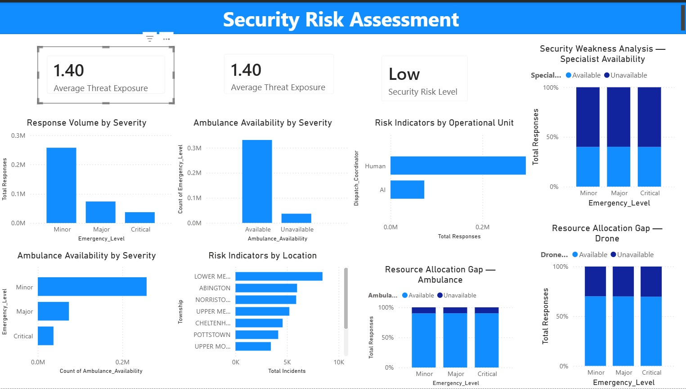
MILESTONE 4 — PART A
Security Risk Assessment Dashboard
Includes:
Threat exposure & operational vulnerability analysis
Risk indicators by location and operational unit
Resource allocation gaps (ambulance, drone, specialists)
Consolidated Security Risk Scorecard — Low risk level
Advanced Threat Incident Analytics & Security Visualization Framework INFOSYS Springboard
06

Slide 7
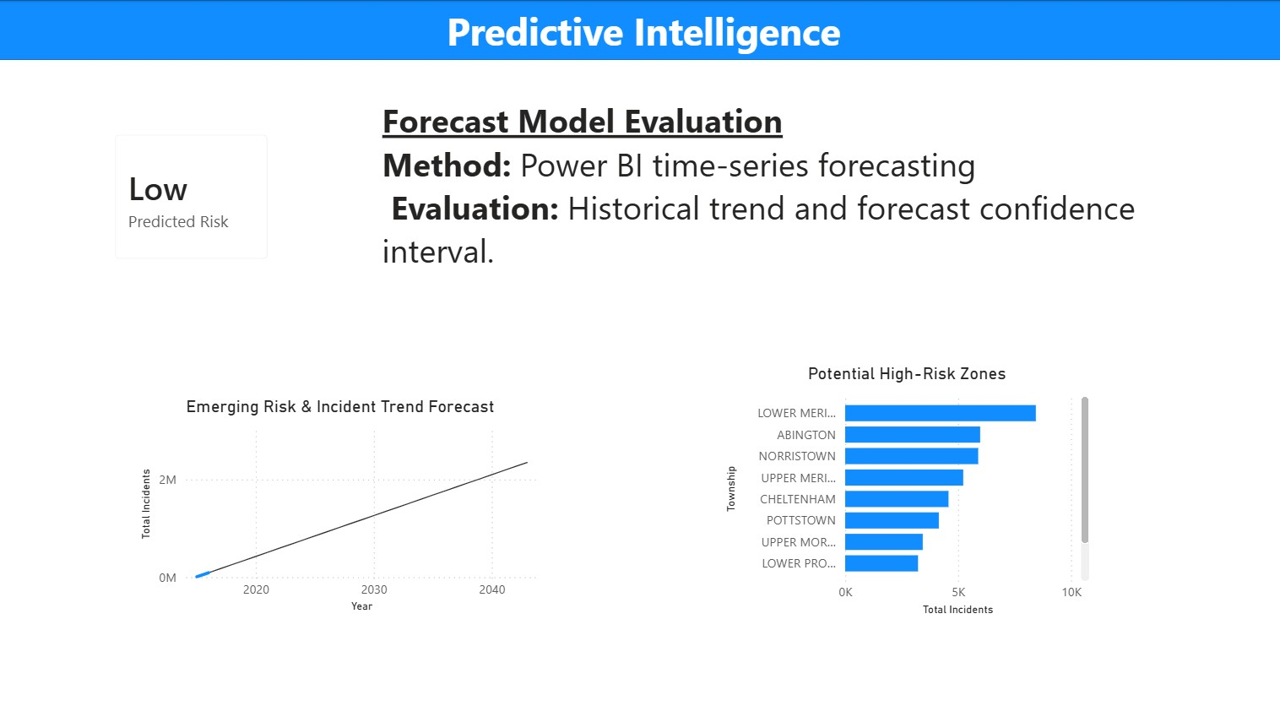
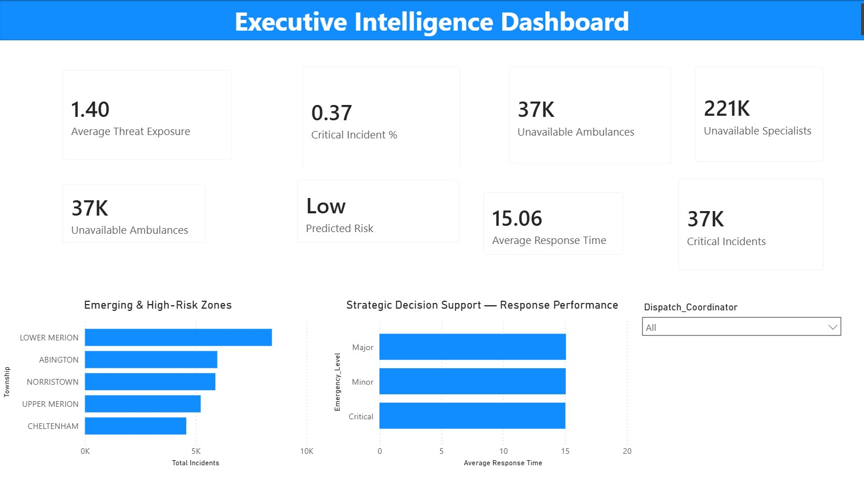
MILESTONE 4 — PART B
Predictive Intelligence & Executive Dashboard
Power BI time-series forecasting projects future incident activity; the Executive dashboard consolidates risk score, high-risk locations and response performance for leadership.
Advanced Threat Incident Analytics & Security Visualization Framework INFOSYS Springboard
07

Slide 8
CONSOLIDATED FINDINGS
Key Insights Across All Milestones
1
Incident & Severity Distribution
2
Geographical Risk Concentration
3
Temporal Demand Patterns
Incidents span EMS, Traffic and Fire categories with clear Minor/Major/Critical severity tiers, enabling prioritized response.
Lower Merion, Abington and Norristown consistently show the highest incident concentration and emerge as high-risk zones.
Hourly, daily and seasonal trends reveal peak-activity periods and activity spikes that inform staffing decisions.
4
Response Performance
5
Operational Resource Gaps
6
Predictive Outlook
Response time varies meaningfully by severity, city and dispatch coordinator, highlighting where operations need improvement.
Ambulance and specialist availability analysis exposes resource gaps that are potential vulnerabilities.
Time-series forecasting projects rising future incident activity, supporting proactive, forward-looking planning.
Advanced Threat Incident Analytics & Security Visualization Framework INFOSYS Springboard
08

Slide 9
STRATEGIC OUTPUT
Business Recommendations
R1
Prioritize High-Severity & High-Risk Locations
Direct monitoring and response resources toward Critical/Major incidents and geographically concentrated risk zones such as Lower Merion and Abington.
R2
Improve Response Planning
Investigate cities and operational units with comparatively higher response times to resolve resource or distance-related bottlenecks.
R3
Optimize Resource Scheduling
Use identified peak hours and high-activity seasons to adjust staffing and emergency-resource availability proactively.
R4
Close Operational Resource Gaps
Address recurring ambulance and specialist-availability shortages to strengthen emergency response capability.
R5
Use Forecasts for Proactive Planning
Incorporate the incident-trend forecast into operational planning ahead of predicted periods of increased demand.
Advanced Threat Incident Analytics & Security Visualization Framework INFOSYS Springboard
09

Slide 10
SCOPE & RIGOR
Data Limitations & Predictive Notes
Data Limitations
Predictive Approach — Notes
The source data did not contain reliable resolution timestamps or dedicated incident-status fields. As a result, Average Resolution Time, Open/Closed Incident analysis, and Response Status Distribution were intentionally not fabricated — keeping the dashboard grounded in valid source information.
Uses Power BI time-series forecasting, not a separately trained ML model
Rule-based risk indicator classifies exposure as High / Medium / Low from a severity-weighted score
Forecast confidence intervals indicate uncertainty around the trend
No accuracy, precision, recall or F1-score — those metrics apply only to trained ML models
Advanced Threat Incident Analytics & Security Visualization Framework INFOSYS Springboard
10

Slide 11
CONCLUSION
A Complete Journey — from Raw Data to Predictive Security Intelligence
Across four milestones, the framework evolved from cleaned, modeled incident data into a full analytics suite covering threat classification, geospatial risk, temporal patterns, response performance, security risk scoring, and predictive, executive-level intelligence — built end-to-end in Power BI.
Thank you
Infosys Springboard Virtual Internship • Hansika Shaw

